Slide 1
ML4MI Bootcamp: Network training strategies
Updated:
Aug 24, 2021
Contributors:
Tyler J Bradshaw ( tbradshaw@wisc.edu )

Slide 2
If at first you don’t succeed…

Slide 3
If at first you don’t succeed…
Overfitting / not enough data
Stuck in LOCAL minimum
Network too small
Validation
Training

Slide 4

What to do about a bad network?
This is surprisingly close.

Slide 5
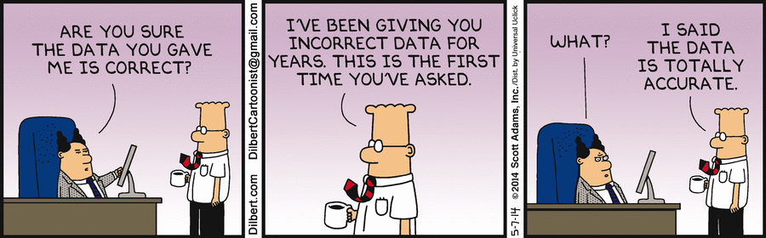

Principles of training a CNN – General principles
Always make sure your images made it through uncorrupted
Always plot and inspect the training/validation loss plot
Helps guide troubleshooting

Slide 6
Principles of training a CNN – Class balancing
Class imbalance (+ inappropriate loss function) can cause misleading results
Maximize accuracy

Slide 7

Principles of training a CNN – Class balancing
Class imbalance (+ inappropriate loss function) can cause misleading results
Maximize accuracy
Easy!

Slide 8
Principles of training a CNN – Class balancing
Class imbalance (+ inappropriate loss function) can cause misleading results
Maximize accuracy
Balanced classes

Slide 9
Principles of training a CNN – Class balancing
Class imbalance (+ inappropriate loss function) can cause misleading results
Warning: models trained on balanced classes may perform poorly when facing natural class distributions
Recommendation: 1st stage of training with balanced classes, 2nd stage with natural class distributions
Maximize accuracy
Balanced classes

Slide 10
Hyperparameter optimization
There are a lot of decisions when you’re ready to build a network
Two general options
Compare several pre-existing network architectures (recommended)
Build a network from scratch and optimize the hyperparameters for your problem
Random or grid search of hyperparameters (Bergstra, 2012)
Python packages do this (e.g., Talos, hyperas, keras_tuner)
For every problem, expect to train and compare multiple networks (so save models often and use informative names)
Don’t overfit to the testing dataset!
Hyperparameter | Conventional wisdom
Number of layers | Scale based on size of data
Number of filters at each layer | Scale based on size/complexity of data
Weight initialization | Any common randomization method
Learning rate (speed, decay) | Trial and error, decay can help
Number of epochs | Trial and error (inspect loss plots)
Batch size | Lower is better, but takes longer (~20-40)
Convolution filter sizes | 3x3 is most common/efficient
Dropout rate | 0.5 is most common
Number of dense nodes | Scale based on size/complexity of data
Image input size | Commonly between 80x80 and 400x400
Optimizer | Adam, Nadam, RMSprop (or similar)
Pre-training | Usually helps, depending on data size
Novelties (residual, inception blocks) | Trial and error
Activation functions | ReLU (or leaky ReLU or similar)
List of hyperparameter optimization packages: https://medium.com/@mikkokotila/a-comprehensive-list-of-hyperparameter-optimization-tuning-solutions-88e067f19d9

Slide 11
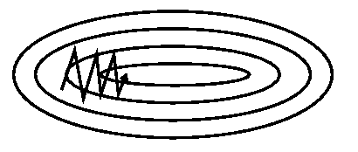
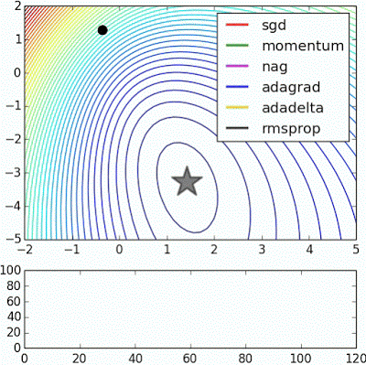
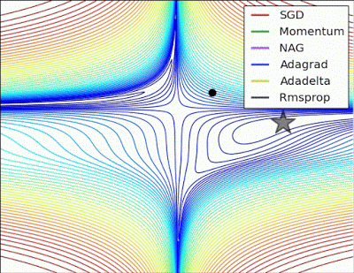
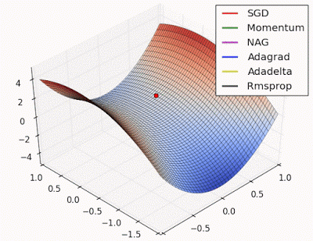
Optimizers
Stochastic gradient descent (SGD) is the baseline optimizer for comparison
Can move slowly, especially when one dimension is steeper than the others
Momentum adds a fraction of previous update vectors to the current update vector (prevents saddle oscillations)
Adam and RMSprop are the most common, but it depends on the data (and you won’t know until you try them!)
Adaptive learning rate for each parameter, momentum
Momentum
https://arxiv.org/pdf/1609.04747.pdf
http://www.denizyuret.com/2015/03/alec-radfords-animations-for.html

Slide 12
Overfitting – Regularization
There is high potential for overfitting
VGG19, with 155 million parameters, could “memorize” training examples
You will encounter a plot like this:
Option 1: Save the model during training (callback functions) and use the model with the best validation accuracy
Option 2: Use regularization
Validation
Training

Slide 13
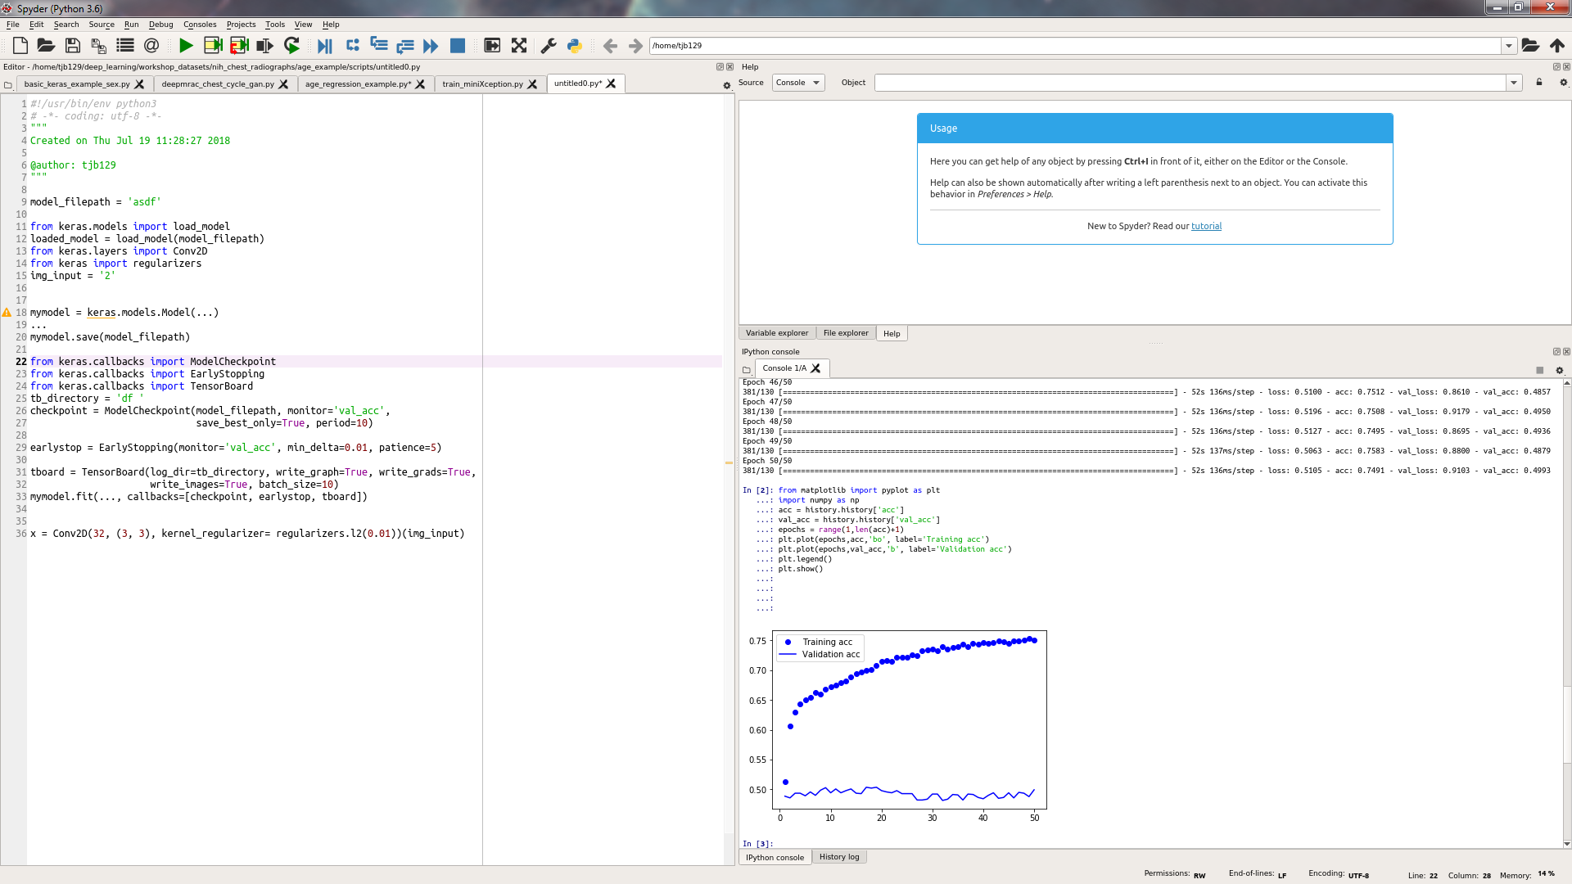
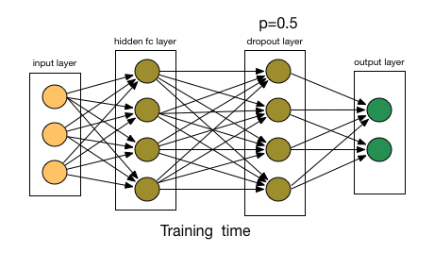
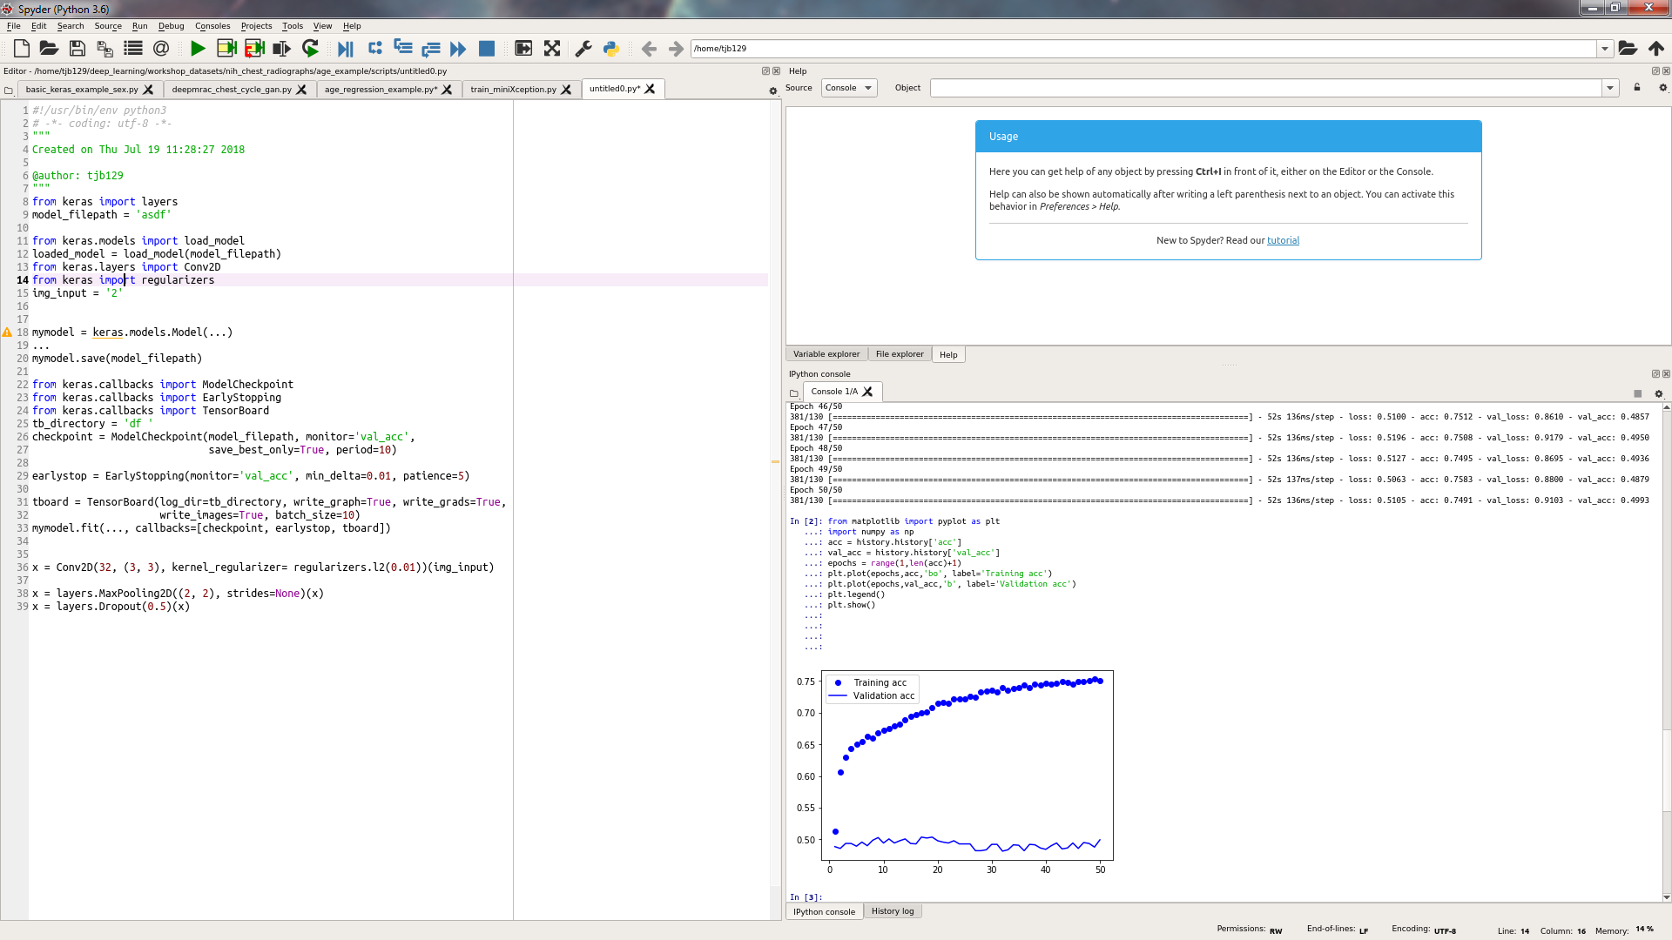
Overfitting – Regularization
L1 & L2 regularization: Add the L1 or L2 norm of the model’s weights to the loss function
Encourages low-valued weights, so network doesn’t depend on just a few nodes
Dropout: During training, randomly drop (set to 0) a fraction of the model’s weights
Forces model to learn multiple/redundant pathways

Slide 14
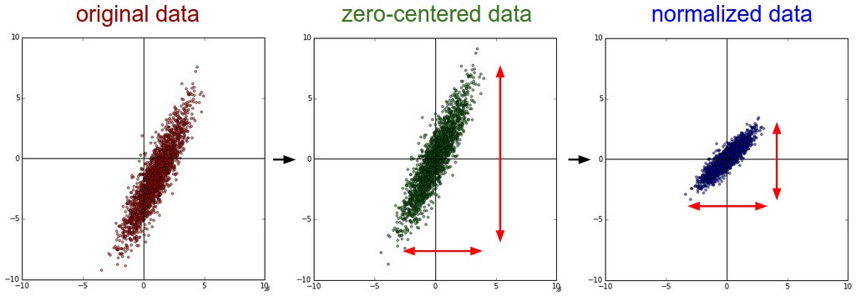
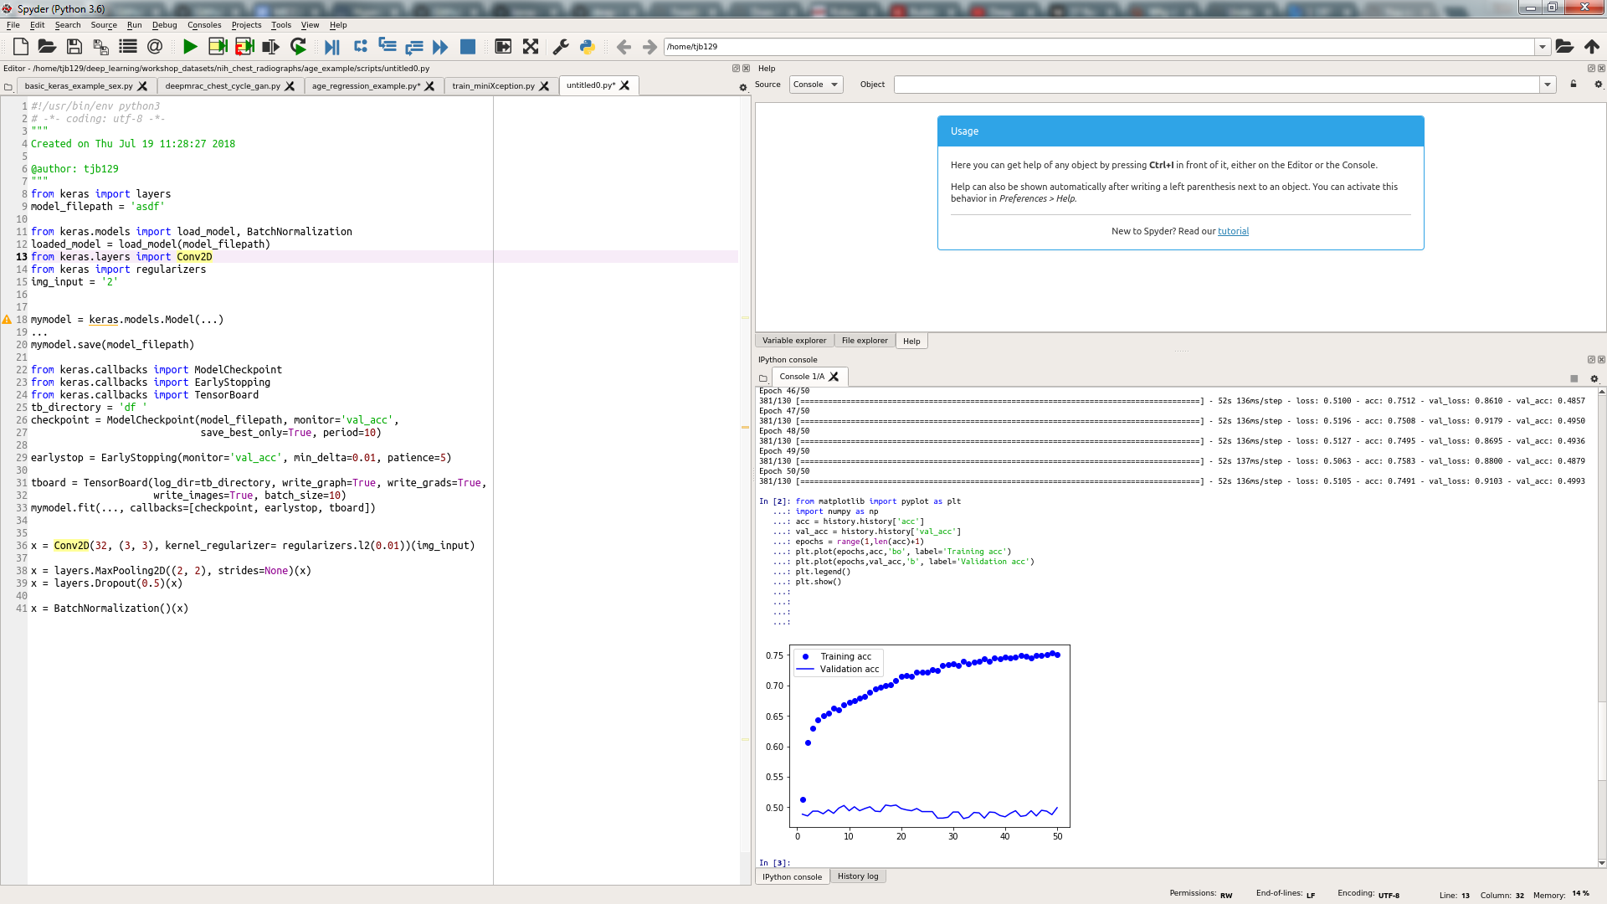
Overfitting – Regularization
Batch normalization: Normalize the output in a layer by all of the outputs in the layer
The outputs then get scaled and shifted via learned weights
Prevents extreme activations
Very powerful, often quoted as one of the greatest recent developments in DL
Shrink your model: Overfitting can be reduced by using a smaller network with fewer weights

Slide 15
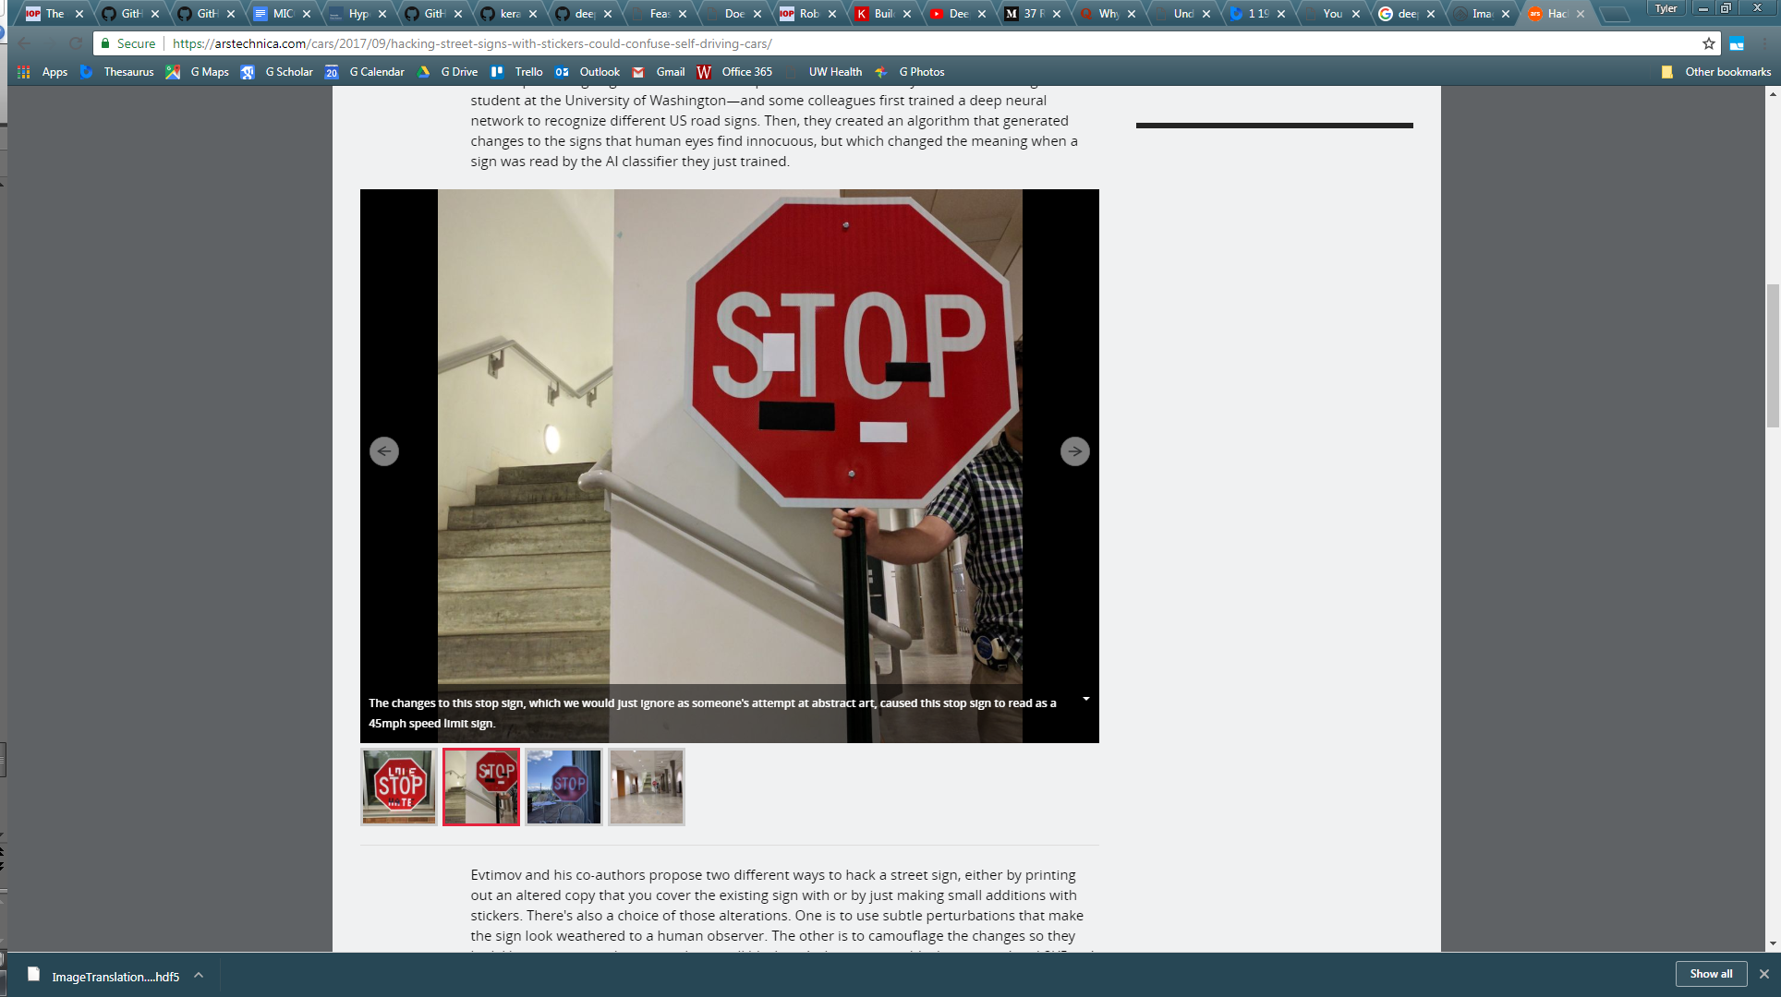
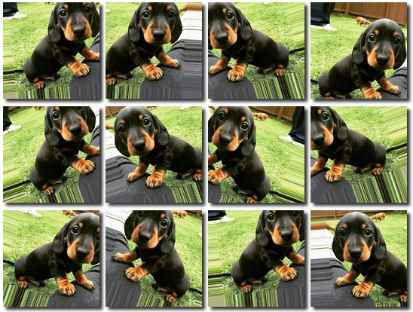
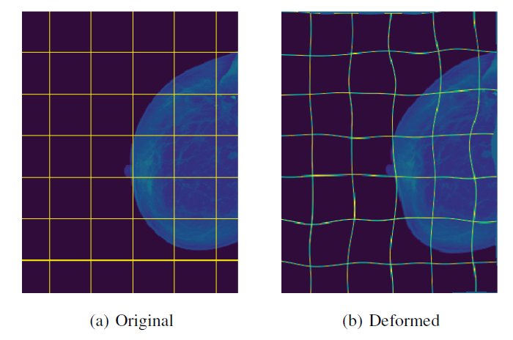
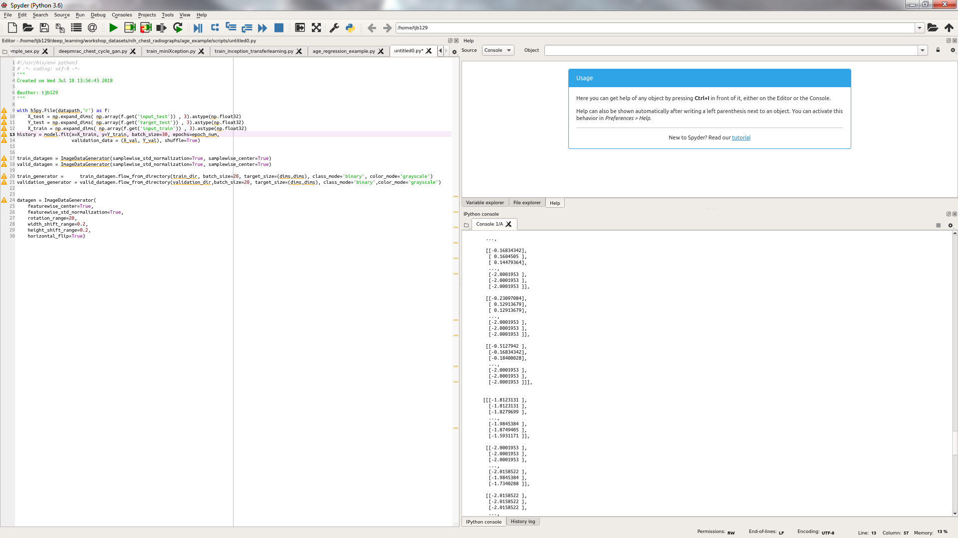
Overfitting – Data augmentation
With small datasets, networks can learn very specific features with little generalizability
By applying random rotations/flips/scaling, you can increase the training data set by 10-fold or more, increasing its generalizability
Doesn’t always make a large impact
Can be performed on the fly with ImageDataGenerator
Was interpreted as “45 mph” sign
https://arstechnica.com/cars/2017/09/hacking-street-signs-with-stickers-could-confuse-self-driving-cars/
Castro et al, 2018

Slide 16
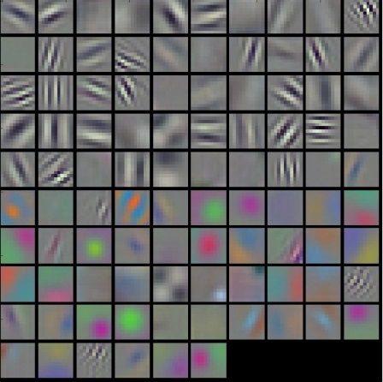
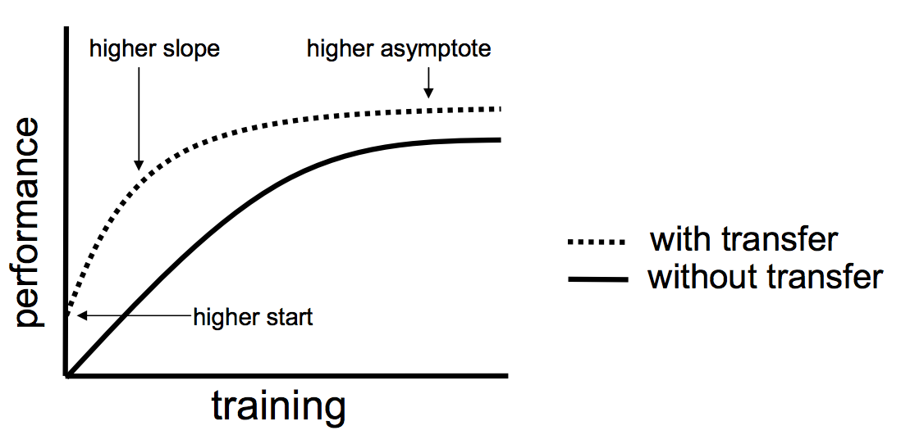
Overfitting – Pre-training/transfer learning
Features learned in different tasks can be quite similar, especially in early layers
You can pre-train your network weights using a large dataset (e.g., ImageNet), then update those weights with your data/task
You can choose to fine tune the entire network, certain layers only, or just the fully-connected classifier at the end
http://cs231n.github.io/understanding-cnn/

Slide 17
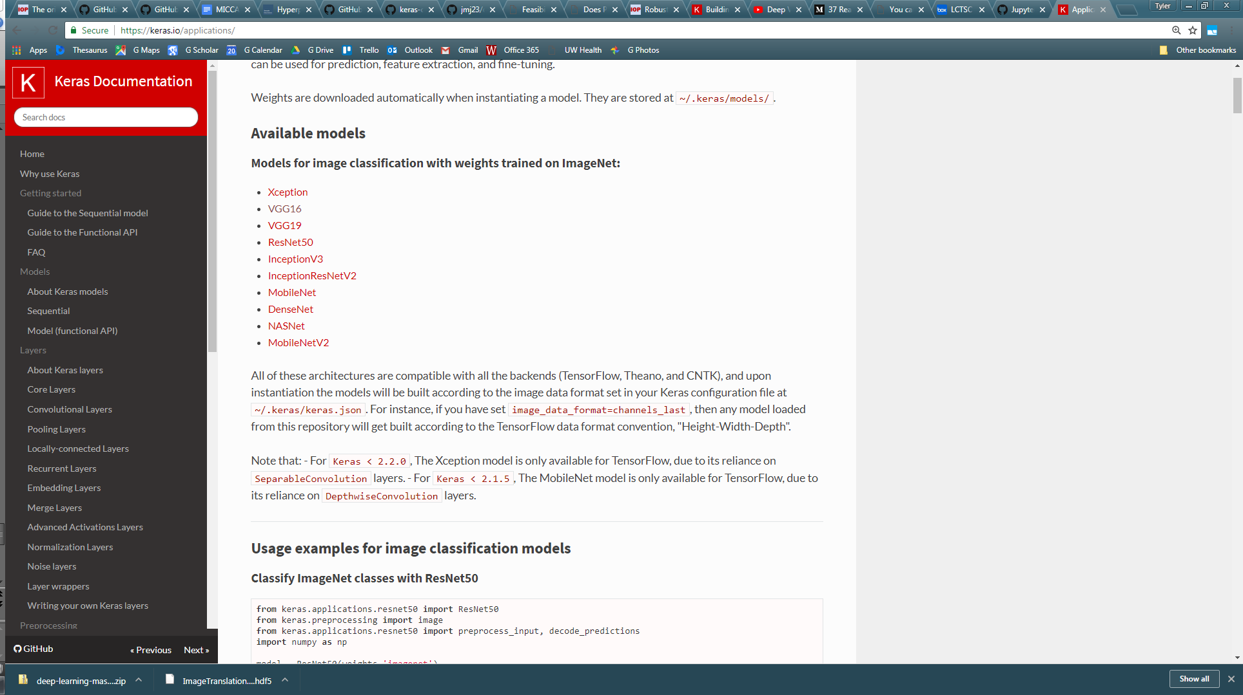
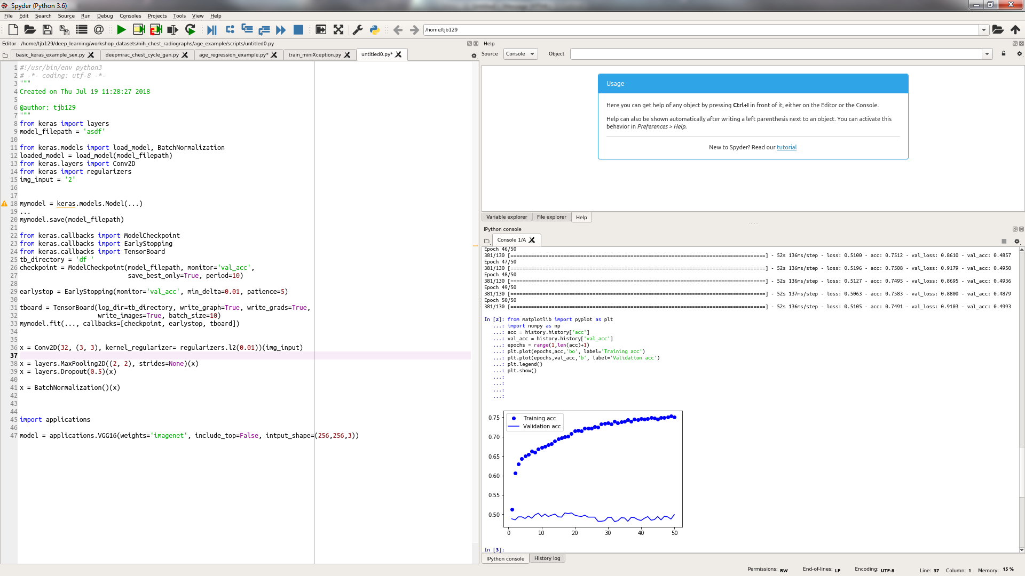
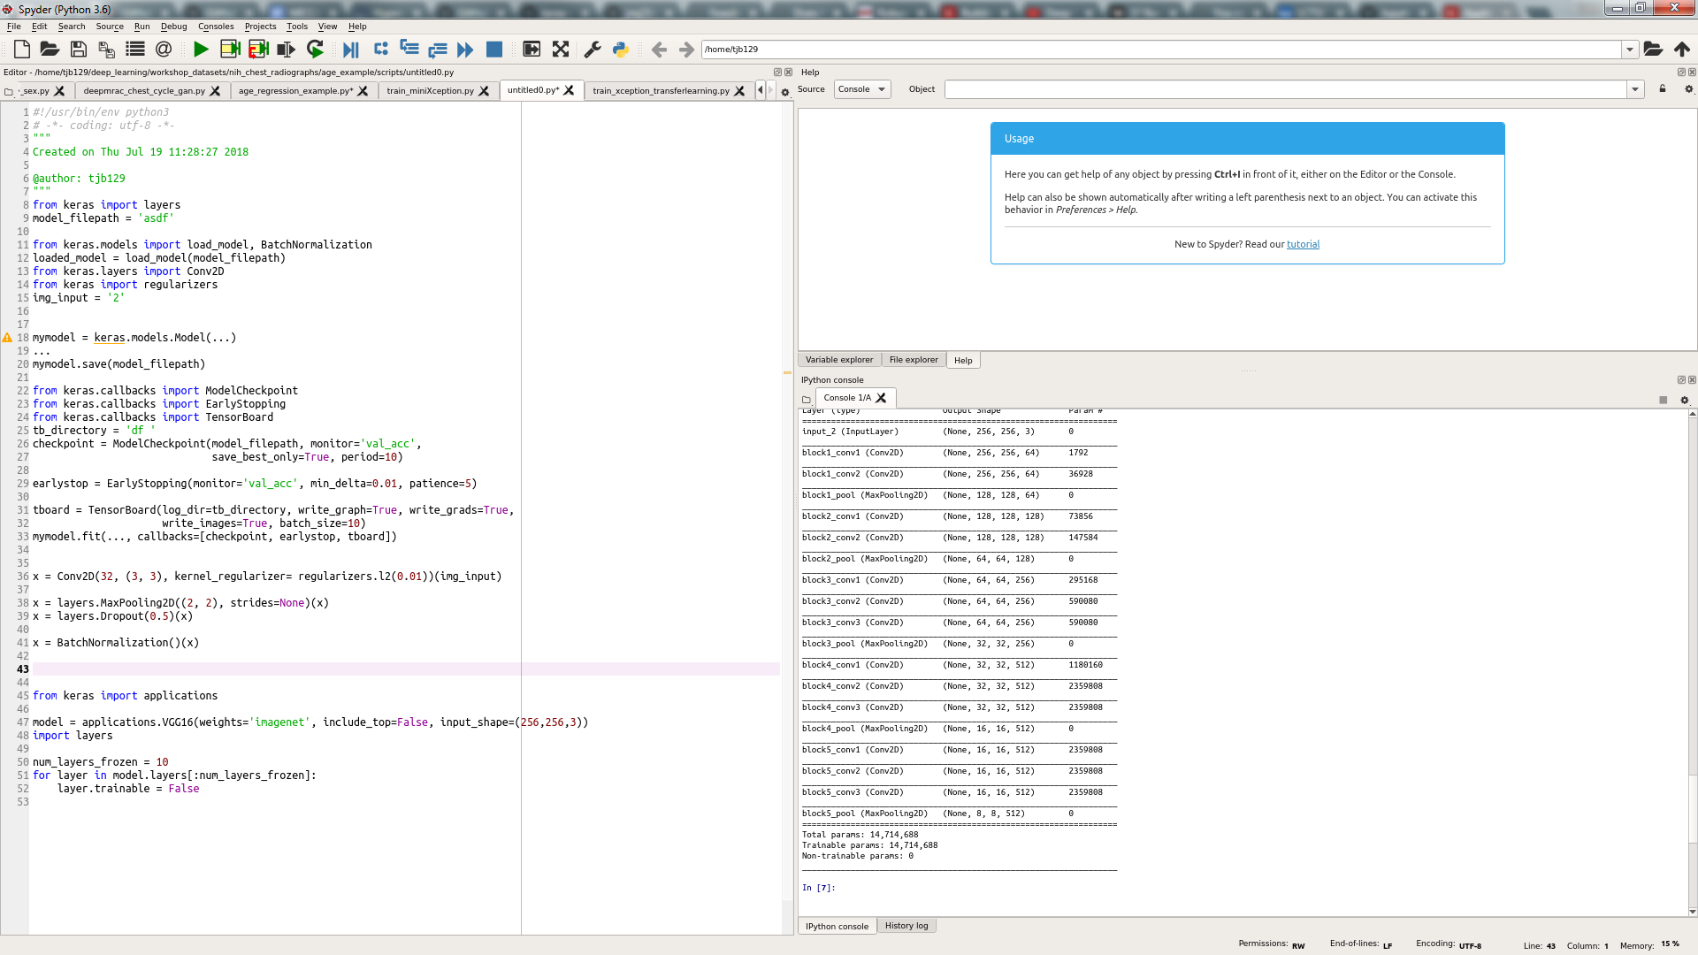
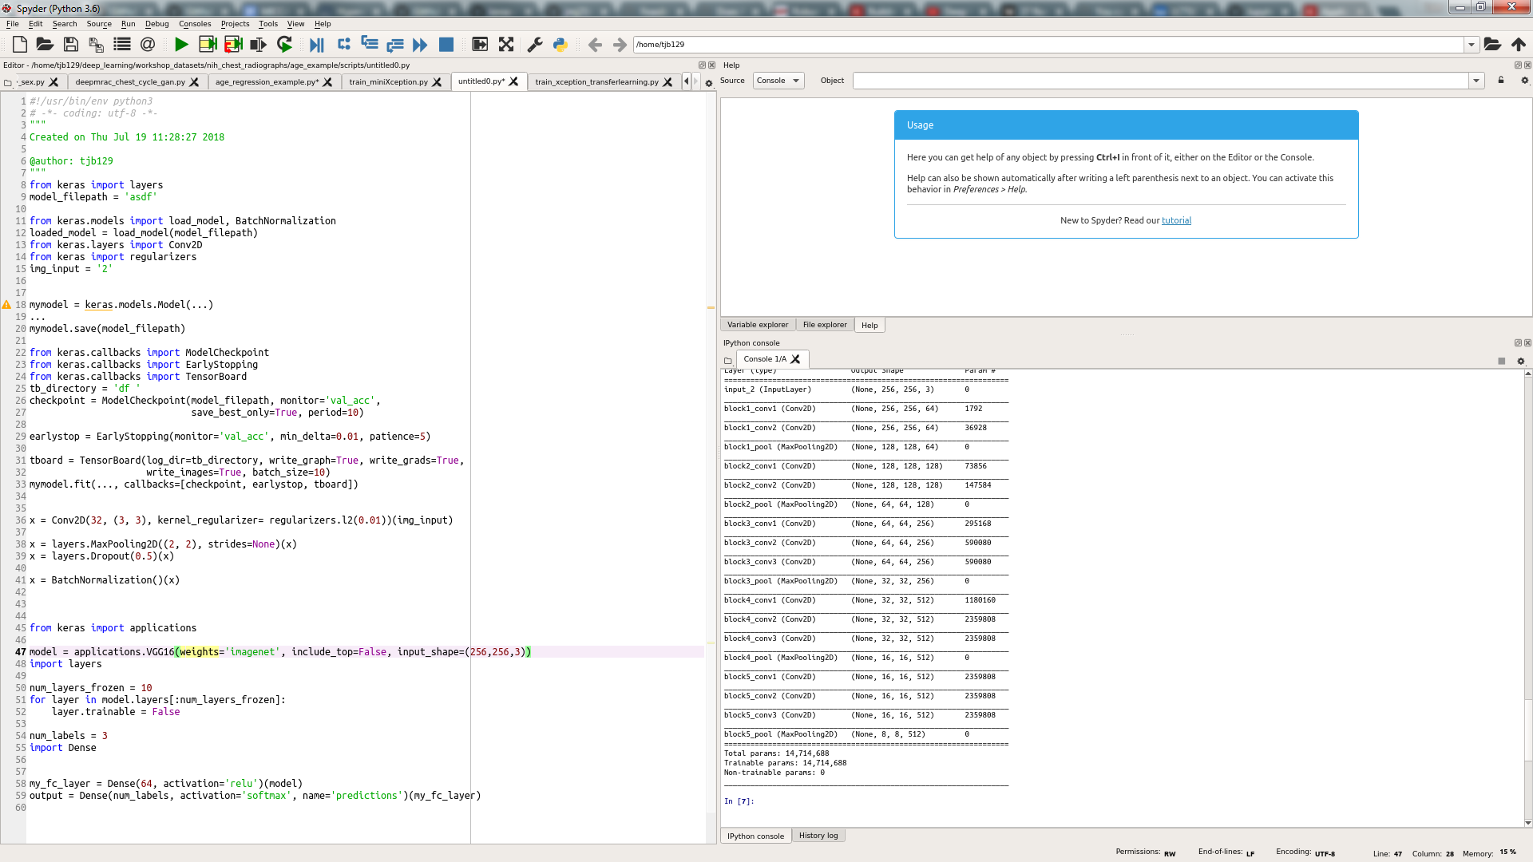
Overfitting – Pre-training/transfer learning
With Keras, transfer learning is easy
You can download pre-trained models with weights for popular CNN architectures
You can set a certain number of layers to be frozen (i.e., untrainable), with the rest being trainable
You can add your own fully-connected layer on top of the model
Include fully connected layer

Slide 18
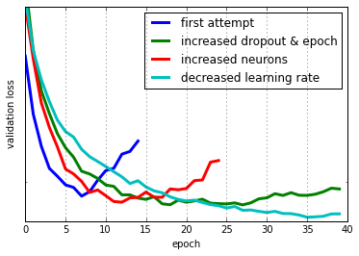
If at first you don’t succeed…try, try again!
Expect that your first network will not work well
Plan on using the training tips listed in this presentation
If you still can’t get satisfactory results
Try different network architectures (dual pathway, residual/inception blocks, etc)
Not all datasets are suitable for deep learning (too few examples, high complexity)
Your “ground truth” may be poor quality – garbage in, garbage out

